Slide 1
UNIT - IV
Linux OS Forensics

Slide 2
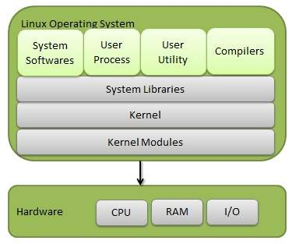
Linux OS Architecture
Linux Operating System has primarily three components
Kernel − Kernel is the core part of Linux. It is responsible for all major activities of this operating system. It consists of various modules, and it interacts directly with the underlying hardware. Kernel provides the required abstraction to hide low level hardware details to system or application programs.
System Library − System libraries are special functions or programs using which application programs or system utilities accesses Kernel's features. These libraries implement most of the functionalities of the operating system and do not require kernel module's code access rights.
System Utility − System Utility programs are responsible to do specialized, individual level tasks.

Slide 3
Linux operating system's architecture mainly contains some of the components: the Kernel, System Library, Hardware layer, System, and Shell utility.
1. Kernel:- The kernel is one of the core section of an operating system. It is responsible for each of the major actions of the Linux OS. This operating system contains distinct types of modules and cooperates with underlying hardware directly. The kernel facilitates required abstraction for hiding details of low-level hardware or application programs to the system. There are some of the important kernel types which are mentioned below:
Monolithic Kernel
Micro kernels
Exo kernels
Hybrid kernels
2. System Libraries:- These libraries can be specified as some special functions. These are applied for implementing the operating system's functionality and don't need code access rights of the modules of kernel.
3. System Utility Programs:- It is responsible for doing specialized level and individual activities.
4. Hardware layer:- Linux operating system contains a hardware layer that consists of several peripheral devices like CPU, HDD, and RAM.
5. Shell:- It is an interface among the kernel and user. It can afford the services of kernel. It can take commands through the user and runs the functions of the kernel. The shell is available in distinct types of OSes. These operating systems are categorized into two different types, which are the graphical shells and command-line shells.

Slide 4
Basic Features
Following are some of the important features of Linux Operating System:
Portable − Portability means software can works on different types of hardware in same way. Linux kernel and application programs supports their installation on any kind of hardware platform.
Open Source − Linux source code is freely available, and it is community-based development project. Multiple teams work in collaboration to enhance the capability of Linux operating system and it is continuously evolving.
Multi-User − Linux is a multiuser system means multiple users can access system resources like memory/ ram/ application programs at same time.
Multiprogramming − Linux is a multiprogramming system means multiple applications can run at same time.
Hierarchical File System − Linux provides a standard file structure in which system files/ user files are arranged.
Shell − Linux provides a special interpreter program which can be used to execute commands of the operating system. It can be used to do various types of operations, call application programs. etc.
Security − Linux provides user security using authentication features like password protection/ controlled access to specific files/ encryption of data

Slide 5
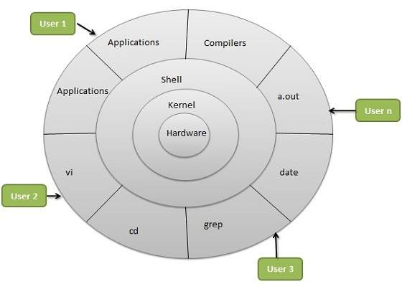
The architecture of a Linux System consists of the following layers −
Hardware layer − Hardware consists of all peripheral devices (RAM/ HDD/ CPU etc.).
Kernel − It is the core component of Operating System, interacts directly with hardware, provides low level services to upper layer components.
Shell − An interface to kernel, hiding complexity of kernel's functions from users. The shell takes commands from the user and executes kernel's functions.
Utilities − Utility programs that provide the user most of the functionalities of an operating systems.

Slide 6
Linux File Ownership
Every Linux system have three types of owner:
User: A user is the one who created the file. By default, whosoever, creates the file becomes the owner of the file. A user can create, delete, or modify the file.
Group: A group can contain multiple users. All the users belonging to a group have same access permission for a file.
Other: Anyone who has access to the file other than user and group comes in the category of other. Other has neither created the file nor is a group member.
Users and groups can be locally managed in /etc/psswd or /etc/group.
First Character | File Type
- | Normal file
d | Directory
l | Symbolic link
p | Named pipe
b | Blocked device
c | Character device
s | Socket

Slide 7
File Types in Linux:
Basically, there are three types of files. The first character in file permissions under ls -l commands shows the type of file. See the below screenshot and find the type of file matching with table given below the image.
To identify the current permissions set on a file or directory. Run ls -l command on terminal. See below image, highlighted section shows the file type and permissions.
Type of Roles and Permissions
To understand file permission, you must know about Roles and Permission types. There are three types of roles available in Linux systems (User, Group, and Others). Each role has 3 types of permissions (Read, Write, and Execute).
Roles:
User (Owner)
Group (All group members)
Other (All other users
Permissions:
Read (r) – Member can read the file content or List files in a directory
Write (w) – Member can write content to file or Create, list, rename, delete file in a directory
Execute (x) –< Member can execute any file like sheel script or enter to the directory, and access files and directories

Slide 8
Linux Distribution
Linux distribution is an operating system that is made up of a collection of software based on Linux kernel or you can say distribution contains the Linux kernel and supporting libraries and software. And you can get Linux based operating system by downloading one of the Linux distributions and these distributions are available for different types of devices like embedded devices, personal computers, etc. Around 600 + Linux Distributions are available and some of the popular Linux distributions are:
MX Linux
Manjaro
Linux Mint
elementary
Ubuntu
Debian
Solus
Fedora
openSUSE
Deepin
Symbolic Notation
The symbolic notation used to set permission with alphabets as following:
Roles:
u – User
g – Group
o – Other
Permissions:
r – read permission
w – write permission
x – execute permission

Slide 9
We can group most directories into one of four categories:
Application Logs
Event Logs
Service Logs
System Logs

Slide 10
Essential Monitor Logs
/var/log/syslog or /var/log/messages: general messages, as well as system-related information. Essentially, this log stores all activity data across the global system. Note that activity for Redhat-based systems, such as CentOS or Rhel, are stored in messages, while Ubuntu and other Debian-based systems are stored in Syslog.
/var/log/auth.log or /var/log/secure: store authentication logs, including both successful and failed logins and authentication methods. Again, the system type dictates where authentication logs are stored; Debian/Ubuntu information is stored in /var/log/auth.log, while Redhat/CentrOS is stored in /var/log/secure.
/var/log/boot.log: a repository of all information related to booting and any messages logged during startup.
/var/log/maillog or var/log/mail.log: stores all logs related to mail servers, useful when you need information about postfix, smtpd, or any email-related services running on your server.
/var/log/kern: stores Kernel logs and warning data. This log is valuable for troubleshooting custom kernels as well.
/var/log/dmesg: messages relating to device drivers. The command dmesg can be used to view messages in this file.
/var/log/faillog: contains information all failed login attempts, which is useful for gaining insights on attempted security breaches, such as those attempting to hack login credentials as well as brute-force attacks.
/var/log/cron: stores all Crond-related messages (cron jobs), such as when the cron daemon initiated a job, related failure messages, etc.
/var/log/yum.log: if you install packages using the yum command, this log stores all related information, which can be useful in determining whether a package and all components were correctly installed.
/var/log/httpd/: a directory containing error_log and access_log files of the Apache httpd daemon. The error_log contains all errors encountered by httpd. These errors include memory issues and other system-related errors. access_log contains a record of all requests received over HTTP.
/var/log/mysqld.log or /var/log/mysql.log : MySQL log file that logs all debug, failure and success messages. Contains information about the starting, stopping and restarting of MySQL daemon mysqld. This is another instance where the system dictates the directory; RedHat, CentOS, Fedora, and other RedHat-based systems use /var/log/mysqld.log, while Debian/Ubuntu use the /var/log/mysql.log directory.

Slide 11
directories and their uses contain:
/var/log/daemon.log: tracks services running in the background that perform important tasks, but has no graphical output
/var/log/btmp: recordings of failed login attempts
/var/log/utmp: current login state, by user
/var/log/wtmp: login/logout history
/var/log/lastlog: information about the last logins for all users. This binary file can be read by command lastlog.
/var/log/pureftp.log: runs the pureftp process that listens for FTP connections. All connections, FTP logins, and authentication failures get logged here
/var/log/spooler: rarely used and often empty. When used, it contains messages from USENET
/var/log/xferlog: contains all FTP file transfer sessions, including information about the file name and user initiating FTP transfers

